Slide 1
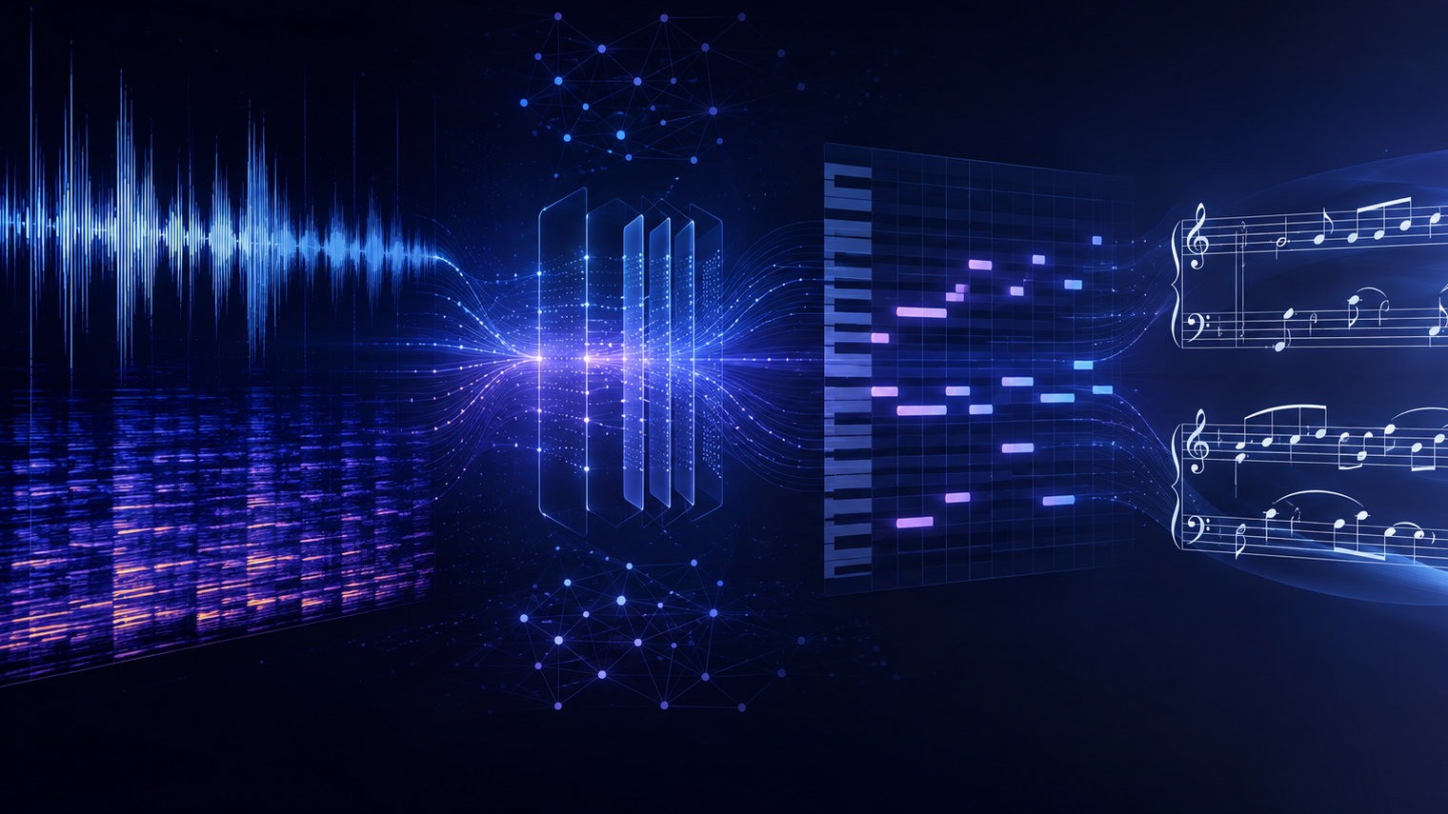
Transformer Based
Music Transcription
& MusicXML Generation
Min Soo Kim

Slide 2
PROBLEM & GOAL
Music transcription is hard because real audio mixes many instruments, timing variations, noise, and performance expression.
●
Mixed sources
◆
Performance timing
▰
Amateur Musicians
♪
Usability
vocals, bass, drums, piano, guitar overlap
human playing does not align perfectly to notation
hard to find sheet music for the pieces they wish to perform
musicians need editable MusicXML, not only MIDI
Generate an editable first draft of sheet music from audio clips

Slide 3
Background
●
MIDI
◆
MusicXML
▰
Source Separation
♪
Music Transcription
A symbolic music format that stores musical events
Includes information such as pitch, note start time, duration, and velocity
Similar to a “digital performance record,” not actual audio
A notation-based file format for sheet music
Stores notes, rests, measures, clefs, time signatures, key signatures, and instrument parts
Can be opened and edited in notation software such as MuseScore
The process of splitting mixed audio into stems
Example stems: vocals, drums, bass, and accompaniment
The process of converting performed audio into symbolic notes
In this project, transcription connects audio input to MIDI-like note data and then to MusicXML sheet music

Slide 4
PIPELINE
Audio File Upload
Preprocessing
librosa / torchaudio
Source Separation
Demucs
Stem Classification
Audio Spectrogram Transformer / Hugging Face fine-tuned classifier
Audio → MIDI
Spotify Basic Pitch
Beat Tracking, Rhythm Quantization, Note Cleanup
Music21 / mido / librosa
MusicXML Generation
music21
Score Render & Export
Musescore / OpenSheetMusicDisplay

Slide 5
Core AI and signal-processing methods
〰
Separate
◉
Classify
♬
Transcribe
Demucs / Hybrid Transformer Demucs
CNN / Audio Spectrogram Transformer / YAMNet
Spotify Basic Pitch / ByteDance piano_transcription
Split mixed audio into various instruments like vocals, drums, bass, and accompaniment stems
Label each stem as melody, bass, piano, guitar, drums or unknown
Convert selected stems into MIDI-like pitch, onset, offset, duration, and velocity.

Slide 6
Core AI and signal-processing methods
〰
Cleanup
◉
MusicXML Generation
♬
Render
Librosa, Madmom, music21, pretty_midi
music21, partitura
OpenSheetMusicDisplay / MuseScore CLI
Convert raw note events into readable notation with beat tracking, tempo estimation, onset alignment
Convert cleaned note events into score format
Users can view, edit, print, and reuse the generated score

Slide 7
Technology Stack
Backend
Frontend
Python / FastAPI
PyTorch / TensorFlow
React / TypeScript
OpenSheetMusicDisplay
librosa / torchaudio / ffmpeg
Demucs + Basic Pitch
Waveform + stem player
Correction interface
music21 / partitura / mido
MuseScore CLI

Slide 8
Expected Outcome
A practical web-based music transcription assistant
that produces editable first-draft sheet music
Converts short audio recordings into editable sheet music
Uses Demucs-based source separation to isolate musical stems
Applies stem classification to identify instrument or musical role
Transcribes audio into MIDI-like note events using Basic Pitch
Supports optional piano-specific transcription for piano stems
Cleans raw transcription through rhythm quantization and symbolic processing
Generates MusicXML for editable notation
Renders scores with MuseScore and OpenSheetMusicDisplay
Creates a practical human-in-the-loop workflow for music transcription

